Slide 1
Advanced Algorithms for Massive Datasets
Basics of Hashing

Slide 2
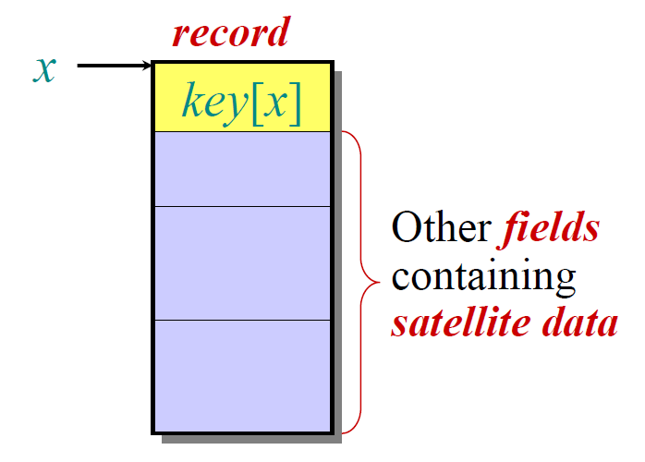
The Dictionary Problem
Definition. Let us given a dictionary S of n keys drawn
from a universe U. We wish to design a (dynamic) data
structure that supports the following operations:
membership(k) → checks whether k є S
insert(k) → S = S U {k}
delete(k) → S = S – {k}

Slide 3
Brute-force: A large array
S
Drawback: U can be very large, such as
64-bit integers, URLs, MP3 files, MPEG videos,...

Slide 4
Hashing: List + Array + ...
Problem: There may be collisions!

Slide 5
Collision resolution: chaining

Slide 6
Key issue: a good hash function
Basic assumption: Uniform hashing
Avg #keys per slot = n * (1/m) = n/m
= α (load factor)

Slide 7
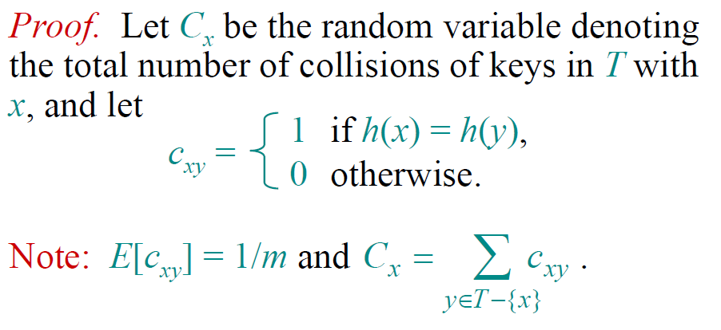
A useful r.v.

Slide 8
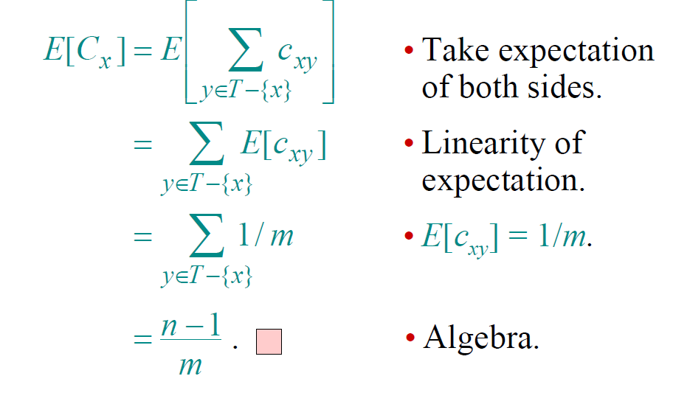
The proof

Slide 9
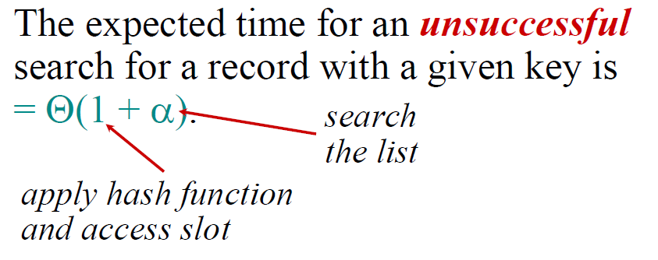
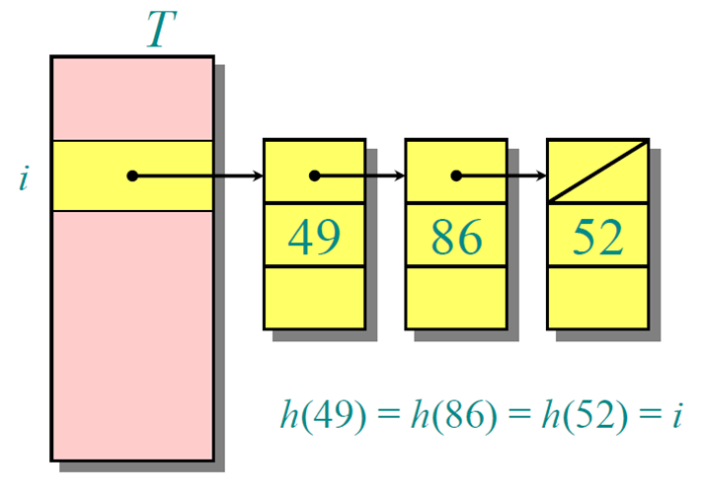
Search cost
m = Ω(n)

Slide 10
In summary...
Hashing with chaining:
O(1) search/update time in expectation
O(n) optimal space
Simple to implement
...but:
Space = m log₂ n + n (log₂ n + log₂ |U|) bits
Bounds in expectation
Uniform hashing is difficult to guarantee
Open addressing
array
chains

Slide 11
In practice
Typically we use simple hash functions:
prime

Slide 12
Enforce “goodness”
As in Quicksort for the selection of its pivot, select the h() at random
From which set we should draw h ?

Slide 13
What is the cost of “uniformity”?
h: U → {0, 1, ..., m-1}
To be “uniform” it must be able to spread every key among {0, 1, ..., m-1}
We have #h = m^{U}
So every h needs:
Ω(log₂ #h) = Ω(U * log₂ m) bits of storage
Ω(U/log₂ U) time to be computed

Slide 14
Advanced Algorithms for Massive Datasets
Universal Hash Functions

Slide 15
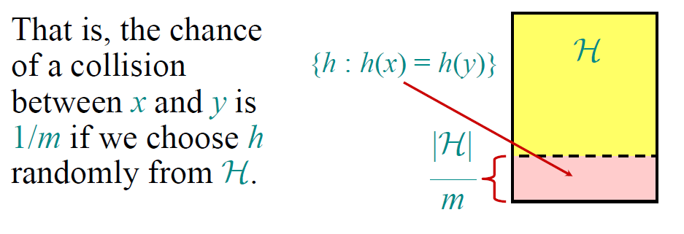
The notion of Universality
For a fixed x,y
This was the key prop of uniform hash + chaining

Slide 16
Do Universal hashes exist ?
U = universe of keys
m = Table size
≈log₂ m
K
k₀
k₁
k₂
k_{r}
r ≈ log₂ U / log₂ m
a
a₀
a₁
a₂
a_{r}
Each a_{i} is selected at random in [0,m)
prime
not necessarily: (...mod p) mod m

Slide 17
{h_{a}} is universal
Suppose that x and y are two distinct keys, for which we assume x₀ ≠ y₀
(other components may differ too, of course)
Question: How many h_{a} collide on fixed x,y ?

Slide 18
{h_{a}} is universal
0 ≤ a_{i} < m
m is a prime
a

Slide 19
Simple and efficient universal hash
h_{a}(x) = ( a*x mod 2^{r} ) div 2^{r-t}
0 ≤ x < |U| = 2^{r}
a is odd
Few key issues:
Consists of t bits, taken from the ≈MSD(ax)
Probability of collision is ≤ 1/2^{t-1} (= 2/m)

Slide 20
Advanced Algorithms for Massive Datasets
Perfect Hashing

Slide 21
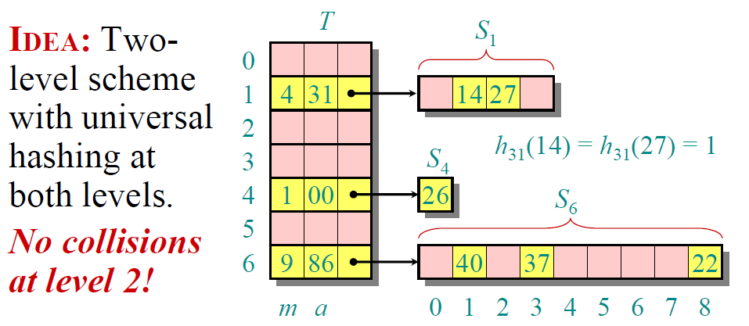
Perfect Hashing
Linear size
Quadratic size
No prime...recall...

Slide 22
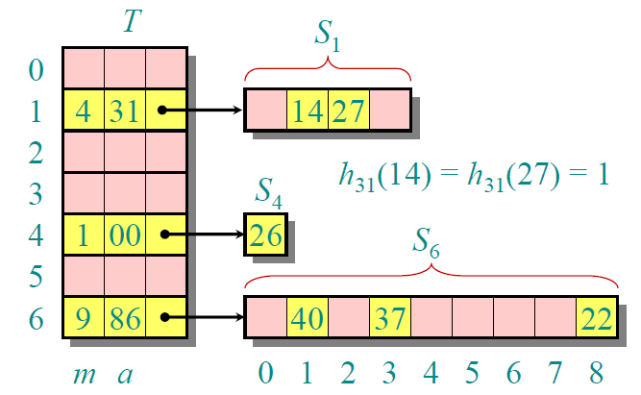
3 main issues:
by construction
Search time is O(1)
Space is O(n)
Construction time is O(n) in expectation
We will guarantee that: m = O(n) and m_{i} = O(n_{i}²), with the h_{i}-functions universal

Slide 23
A useful result
Fact. Given a hash table of size m, n keys,
and a universal hash family H.
If we pick h є H at random, the expected
number of collisions is:
m = n
1° level
2° level
(no collisions)
m = n²

Slide 24
Ready to go! (construction)
O(1) re-draws in exp
Pick h, and check if
∀ slot i, randomly pick h_{i} : U → {0,1, ..., n_{i}²}
...and check if no collisions induced by h_{i} (and in T_{i})

Slide 25
Ready to go! (Space occupancy)
Exp # collisions
at the 1°-level

Slide 26
Advanced Algorithms for Massive Datasets
The power of d-choices

Slide 27
d-left hashing
d
Split hash table into d equal sub-tables
Each table-entry is a bucket
To insert, choose a bucket uniformly in each sub-table
Place item in the least loaded bucket (ties to left)

Slide 28
Properties of d-left Hashing
Maximum bucket load is very small
O(log log n) vs O(log n / log log n)
The case d=2, led to the approach called “the power of two choices”

Slide 29
What is left ?
d-left hashing yields tables with
High memory utilization
Fast look-ups (w.h.p.)
Simplicity
Cuckoo hashing expands on this, combining multiple choices with ability to move elements:
Worst case constant lookup time (as perfect hash)
Dynamicity
Simple to implement

Slide 30
Advanced Algorithms for Massive Datasets
Cuckoo Hashing

Slide 31
A running example
A
B
C
E
D
2 hash tables, and 2 random choices where an item can be stored

Slide 32
A running example
A
B
C
F
E
D

Slide 33
A running example
A
B
C
F
E
D

Slide 34
A running example
A
B
C
F
G
E
D

Slide 35
A running example
E
G
B
C
F
A
D

Slide 36
Cuckoo Hashing Examples
A
B
C
G
E
D
F
Random (bipartite) graph: node=cell, edge=key

Slide 37
Various Representations
Buckets
Buckets
Elements
Elements
Buckets
Buckets
Elements

Slide 38
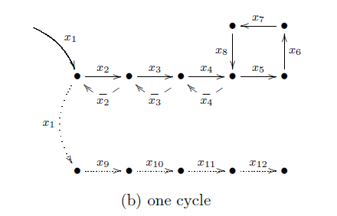
Cuckoo Hashing Failures
Bad case 1: inserted key has very long path before insertion completes.

Slide 39
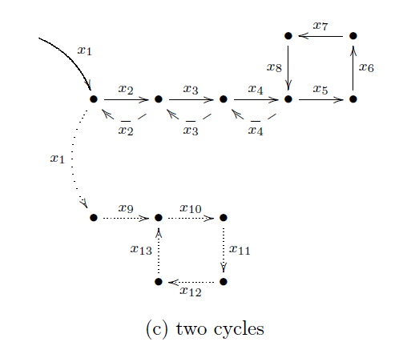
Cuckoo Hashing Failures
Bad case 2: inserted key runs into 2 cycles.

Slide 40
What should we do?
Theoretical solution ( path = O(log n) )
re-hash everything if a failure occurs.
Cost is O(n), how much frequent?
Fact. With load less than 50% (i.e. m > 2n), then n elements give failure rate of Θ(1/n).
Θ(1) amortized time per insertion

Slide 41
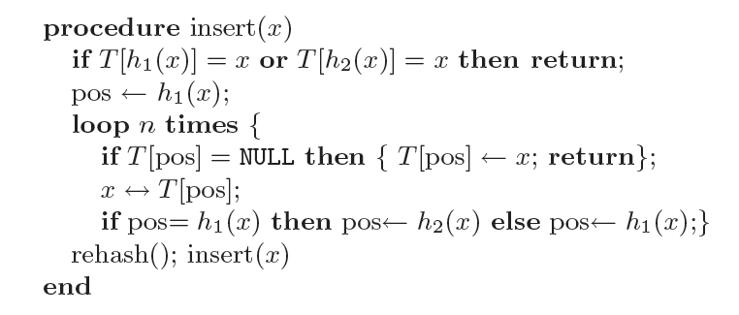
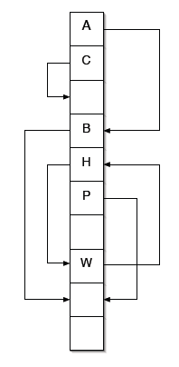
Some more details and proofs
Does not check for emptyness, but inserts directly
possible
danger !!
actually log n, or cycle detect
If unsuccesfull (→ amortized cost)

Slide 42
Key Lemma
Note: The probability vanishes exponentially in l
Proof by induction on l:
l =1. Edge (i,j) created by at least one of n elements
probability is n * (2/r²) ≤ c⁻¹/r
l >1. Path of l -1 edges i→u + edge (u,j)
probability is

Slide 43
Like chaining...
chain
Proof: This occurs if exists a path of some length l between any of {h₁(x),h₂(x)} and any of {h₁(y),h₂(y)}
The positions i,j of the Lemma can be set in 4 ways.
Recall r = table size, so avg chain-length is O(1).

Slide 44
What about rehashing ?
Take r ≥ 2c(1+ε) n, so to manage ε∗n inserts
Probability of rehash ≤ prob of a cycle:
This is ½ for c=3
Prob of k rehash ≤ prob of k cycles ≤ 2^{-k}:
Average cost over ε∗n inserts is O(n) = O(1) per insert

Slide 45
Natural Extensions
More than 2 hashes (choices) per key.
Very different: hypergraphs instead of graphs.
Higher memory utilization
3 choices : 90+% in experiments
4 choices : about 97%
2 hashes + bins of B-size.
Balanced allocation and tightly O(1)-size bins
Insertion sees a tree of possible evict+ins paths
but more insert time
(and random access)
more memory
...but more local

Slide 46
Generalization: use both!
 | B=1 | B=2 | B=4 | B=8
4 hash | 97% | 99% | 99.9% | 100%*
3 hash | 91% | 97% | 98% | 99.9%
2 hash | 49% | 86% | 93% | 96%
1 hash | 0.06% | 0.6% | 3% | 12%
Mitzenmacher, ESA 2009

Slide 47
Minimal Ordered Perfect Hashing
= lexicographic rank
Minimal, not minimum
m = 1.25 n
n=12 → m=15
The h₁ and h₂ are not perfect

Slide 48
h(t) = [ g( h₁(t) ) + g ( h₂(t) ) ] mod n
computed
h is perfect, no strings need to be stored
space is negligible for h₁ and h₂ and it is = m log n, for g

Slide 49
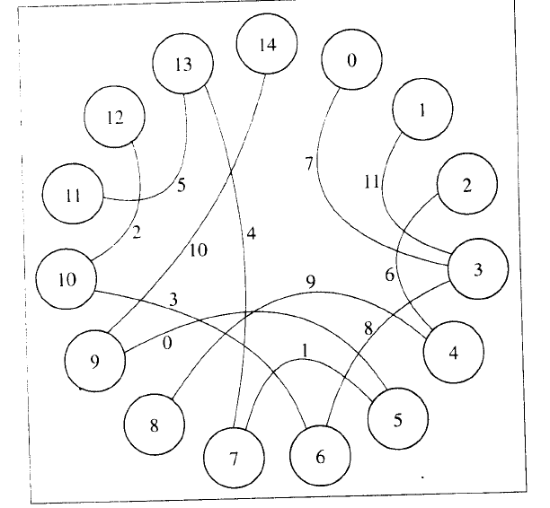
How to construct it
Term = edge, its vertices
are given by h1 and h2
All g(v)=0; then assign g()
by difference with known h()
Acyclic → ok
No-Acycl →
regenerate hashes

